Slide 1
T.H.A.N.O.S.
Two axis reaction wHeel omniwheel unicycle bAlanciNg rObotic Stabilizer
ME 134 Group 8
Sawyer, Ronan + Akshita

Slide 2
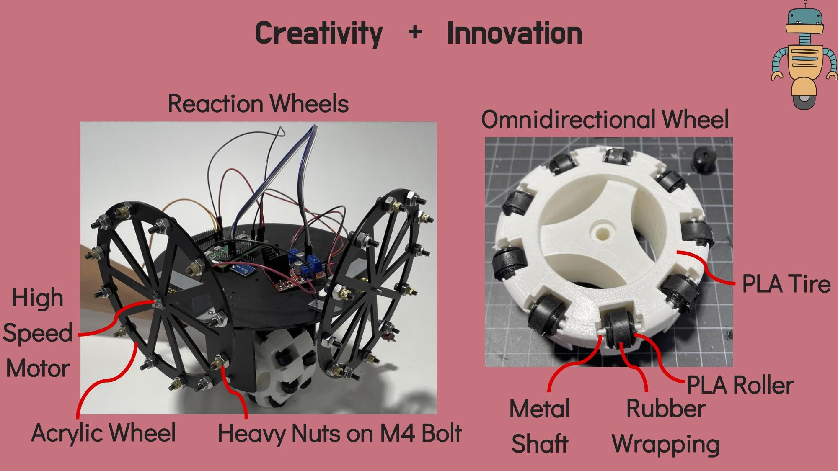
Ronan

Slide 3
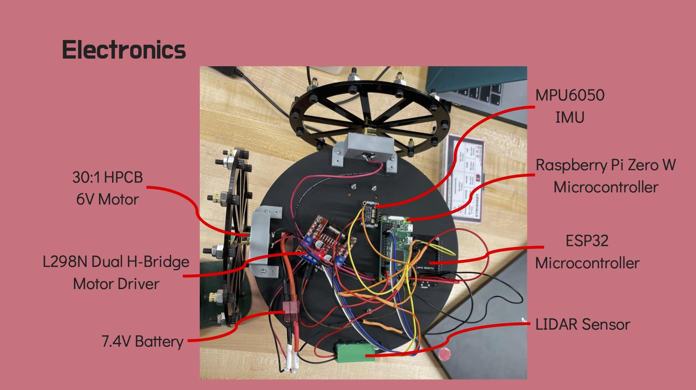
Ronan

Slide 4
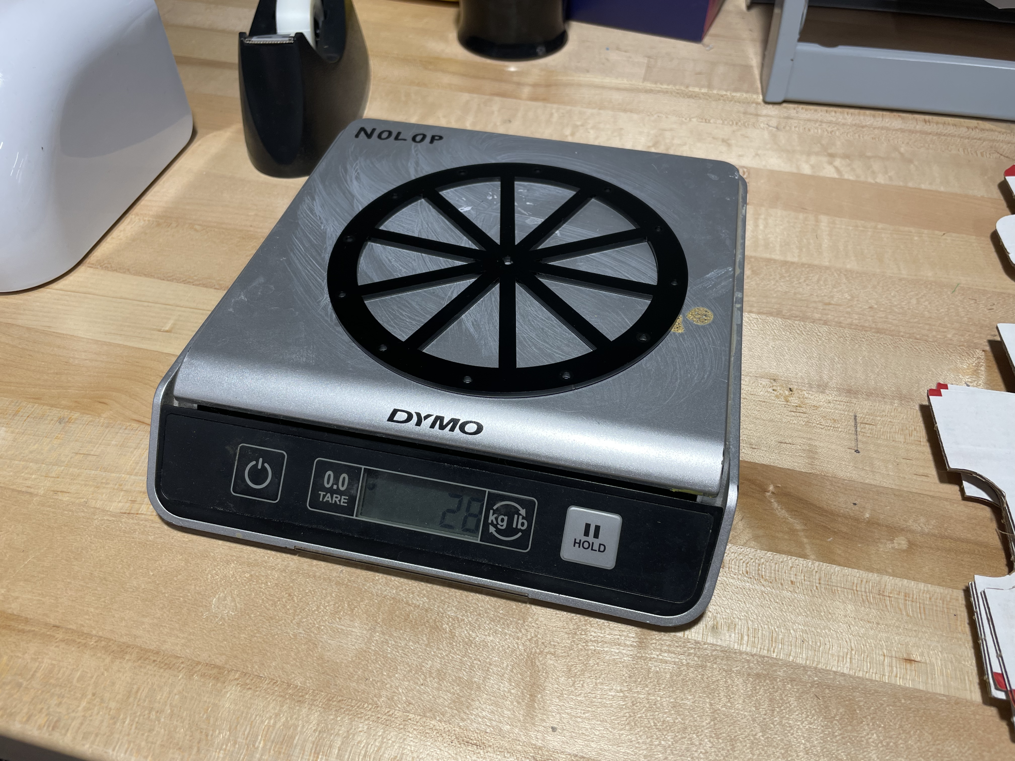
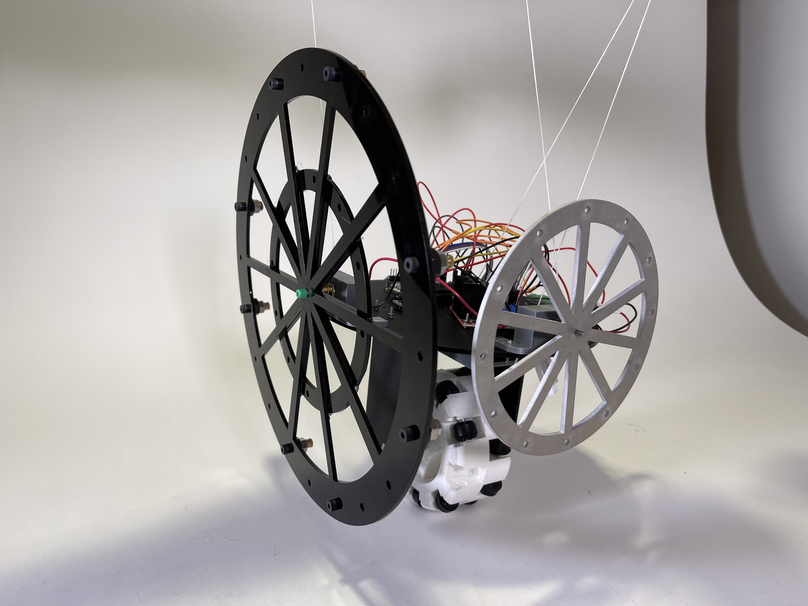
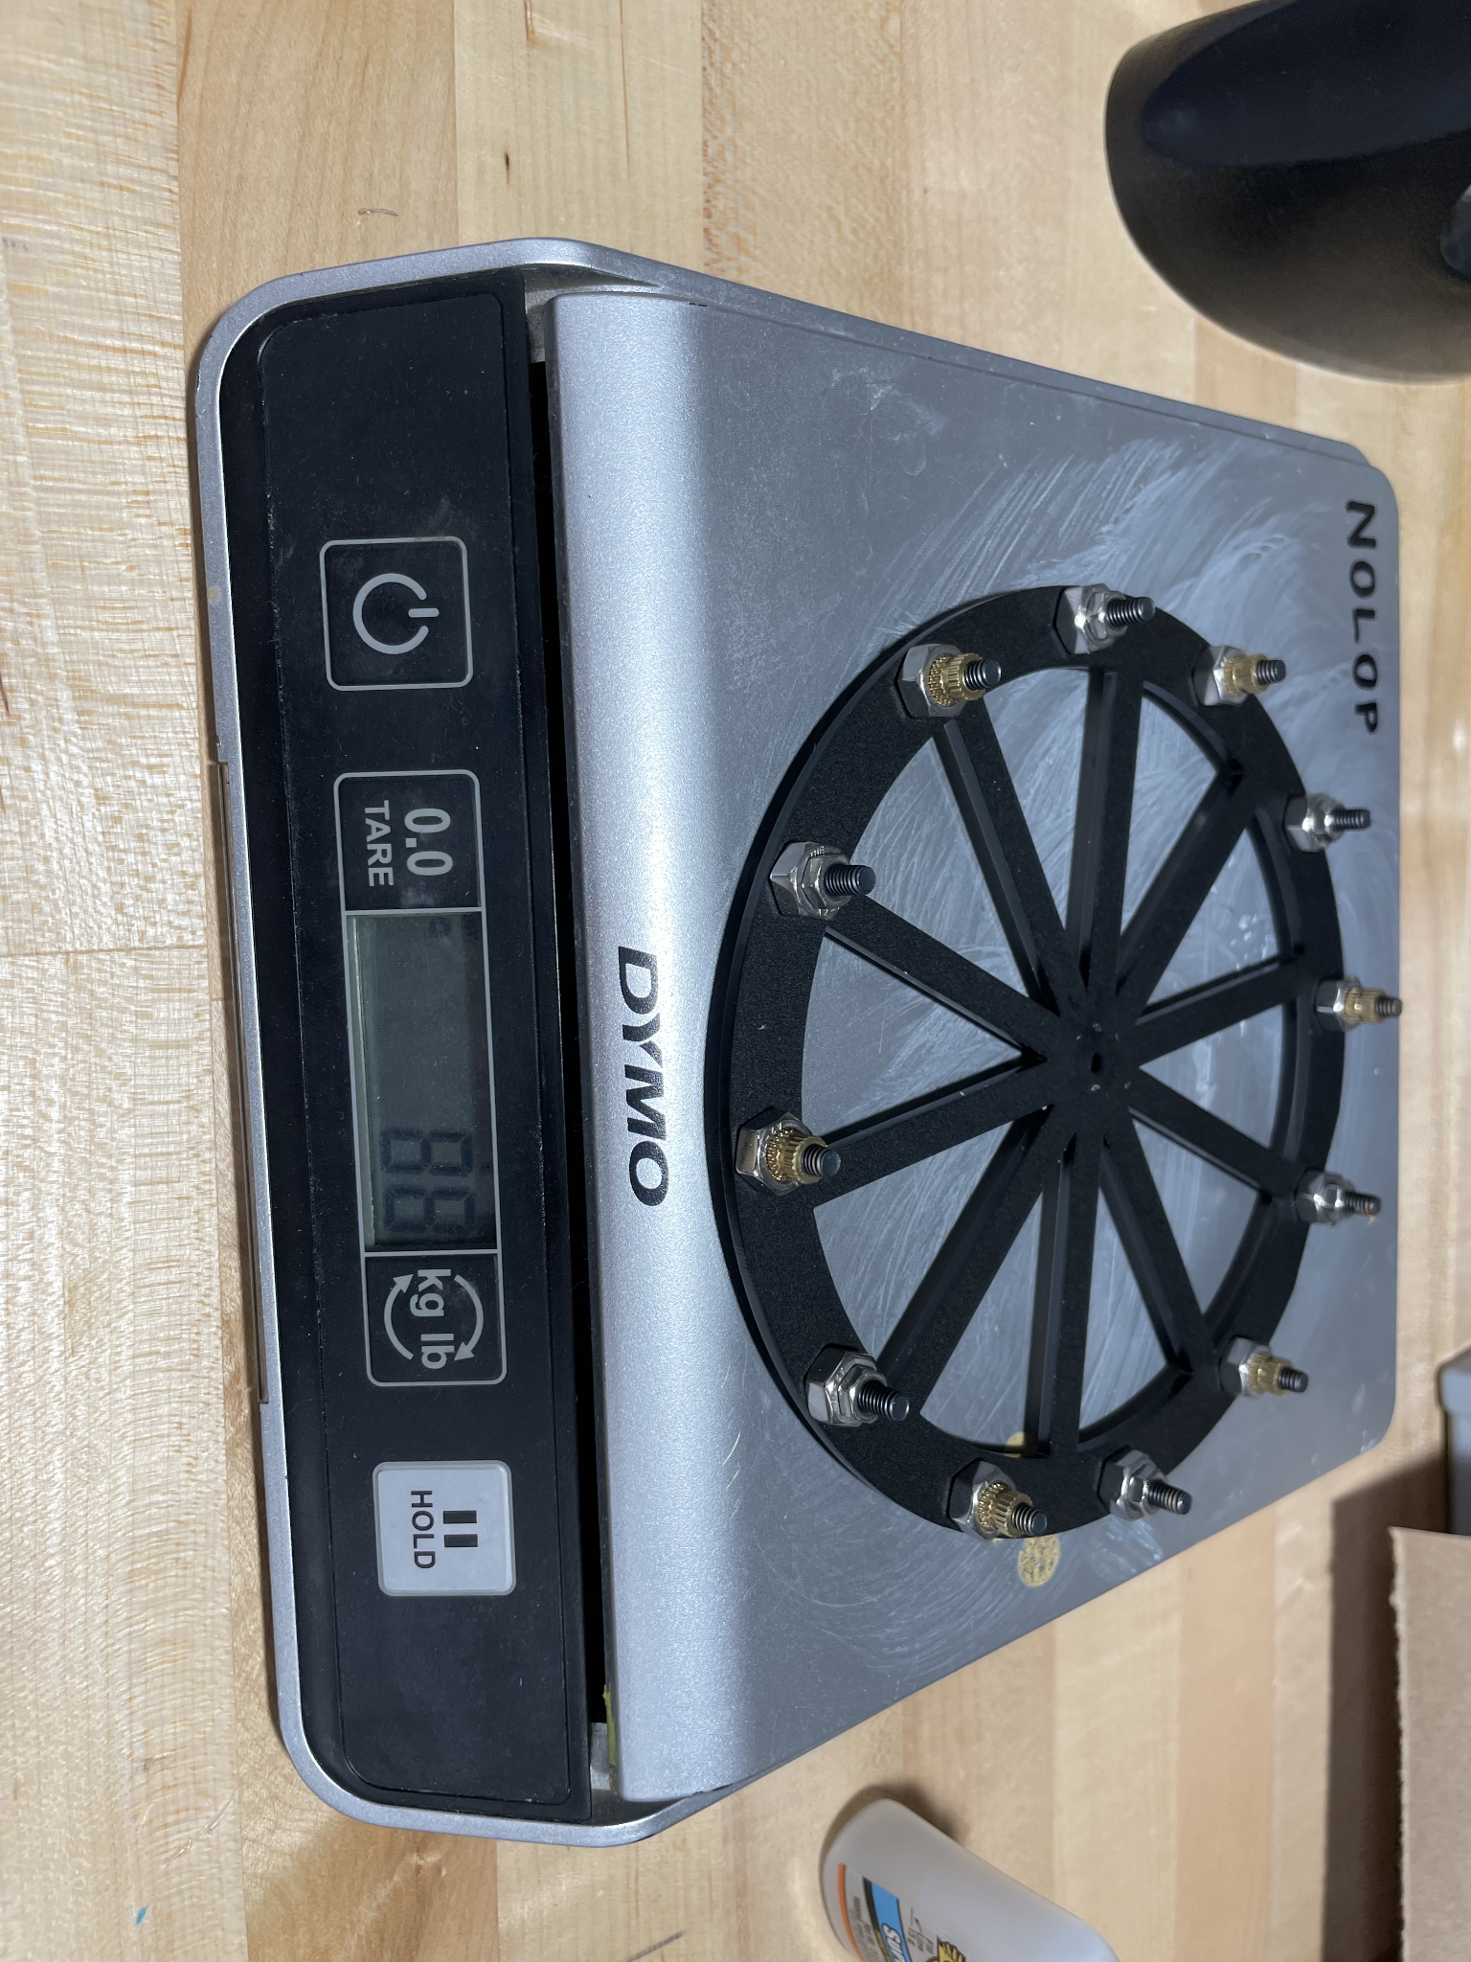
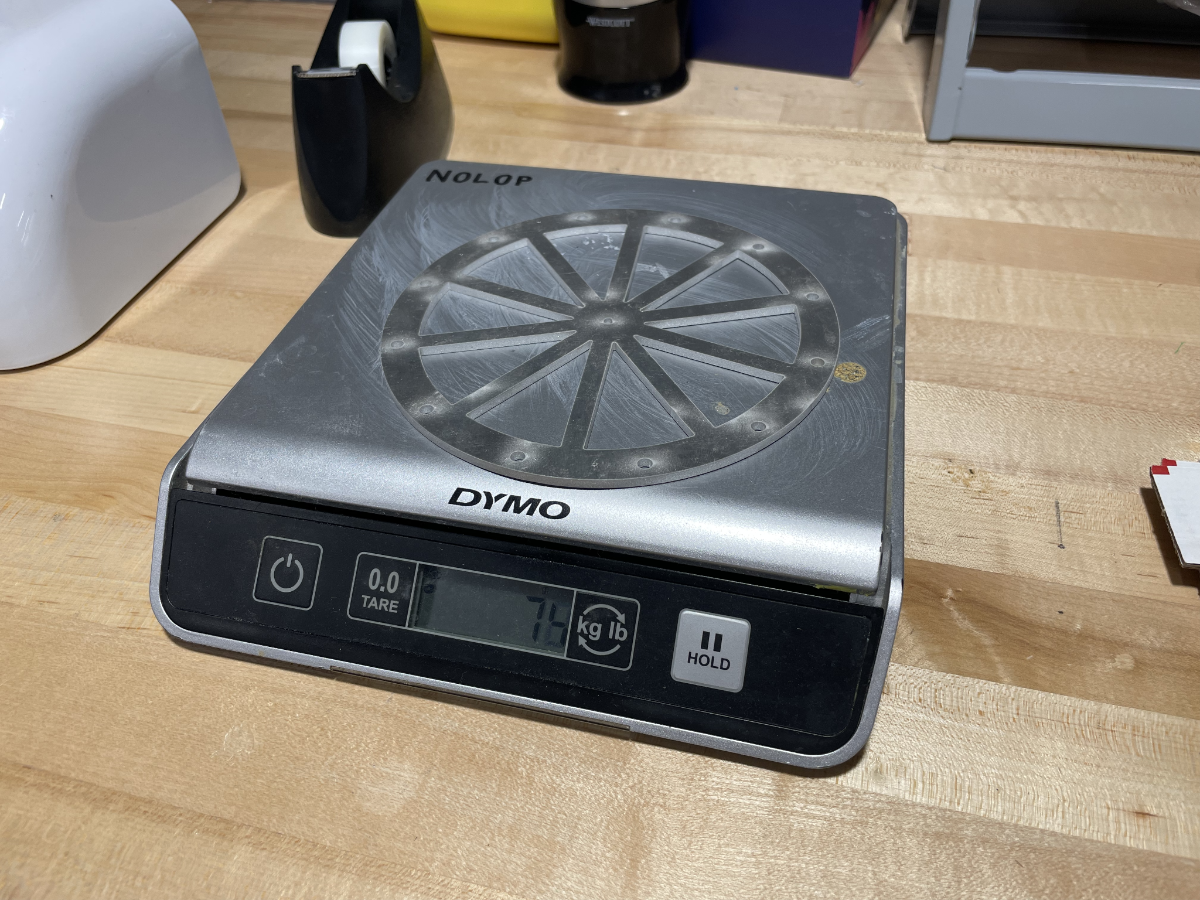
Flywheel Modification
1st Prototype: Acrylic wheel
2nd Prototype: Acrylic wheel w/ weights
Final Prototype: Large acrylic wheel + small aluminum wheel
3rd Prototype: Aluminum wheel
Akshita

Slide 5
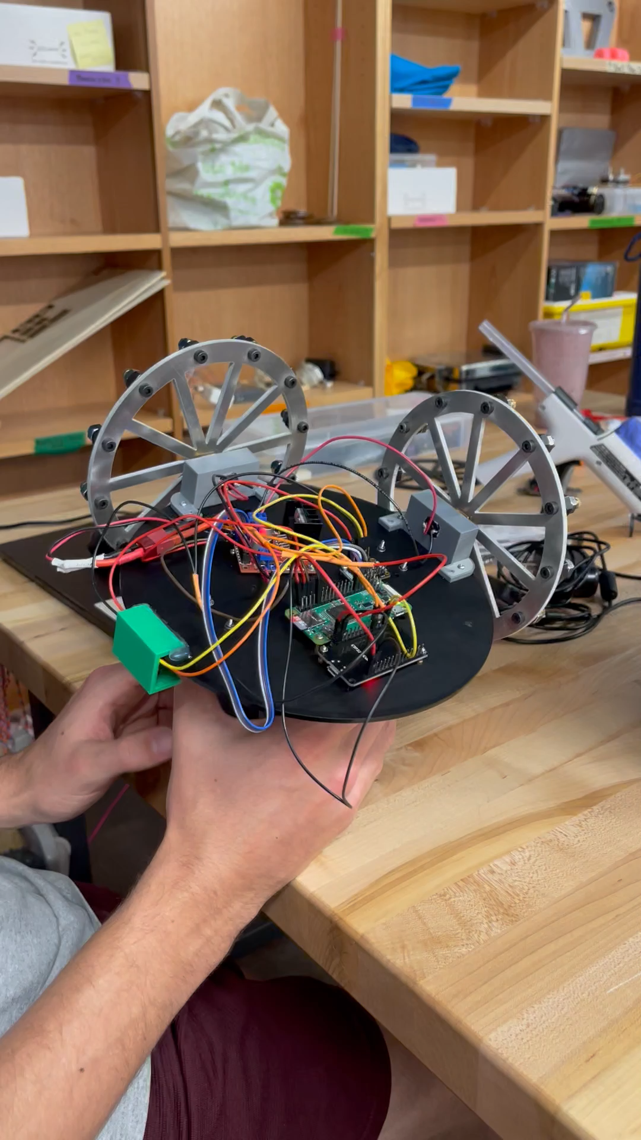
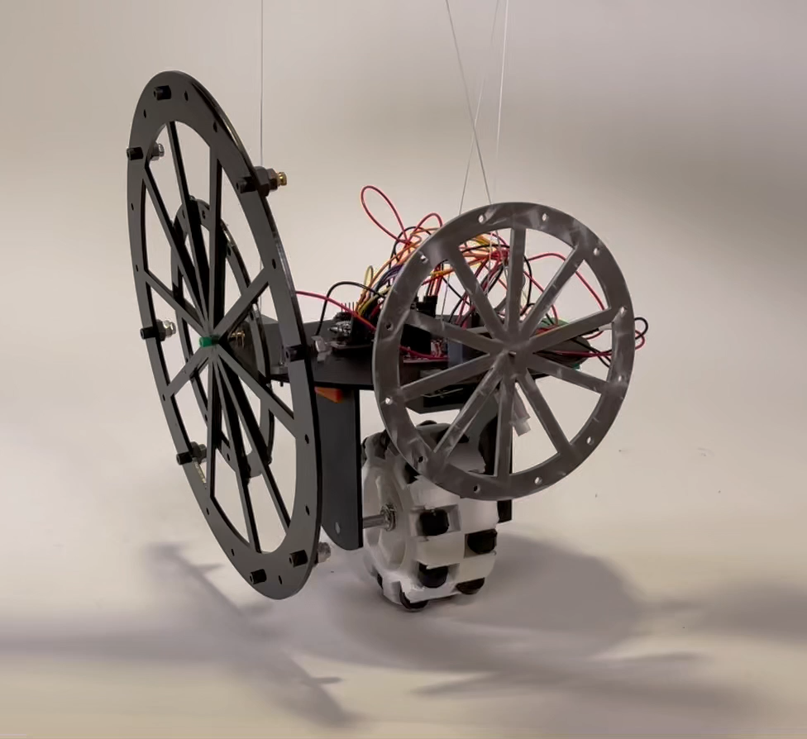
Final Model
Akshita
Waterjet aluminum wheels
Large flywheel provided momentum needed

Slide 6
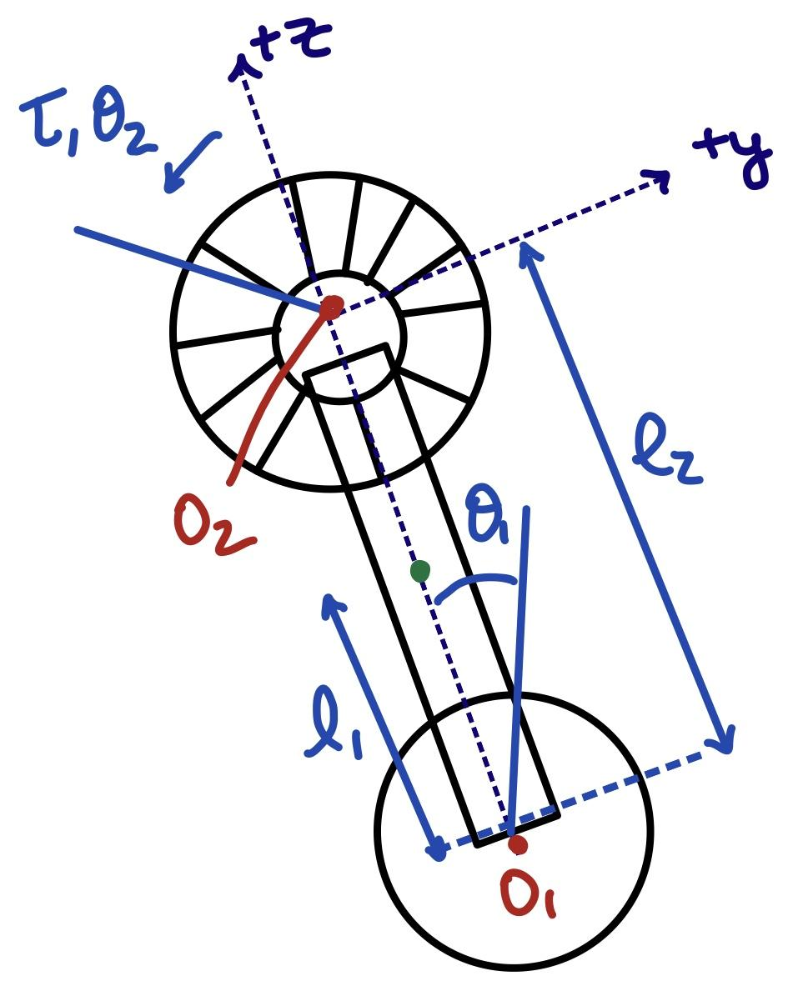
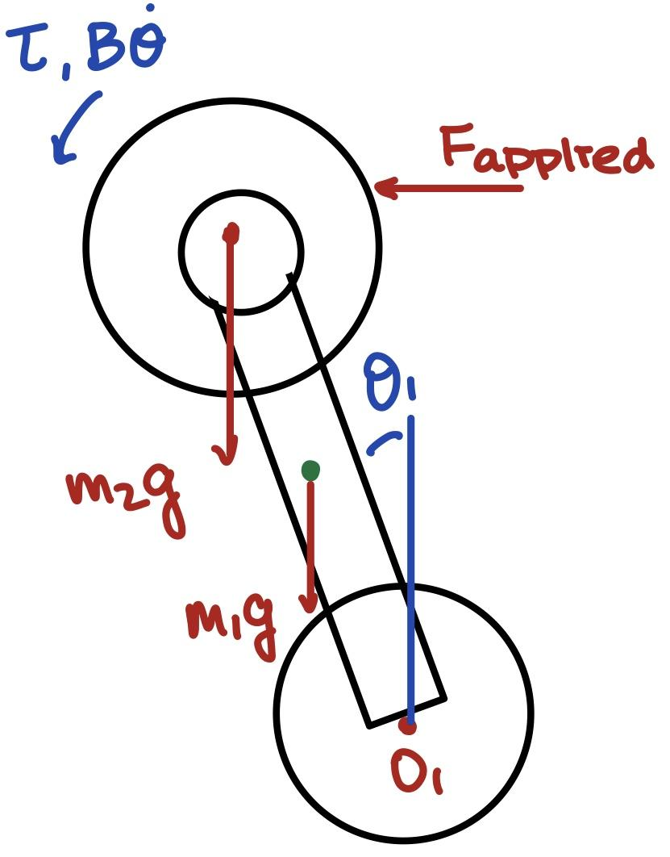
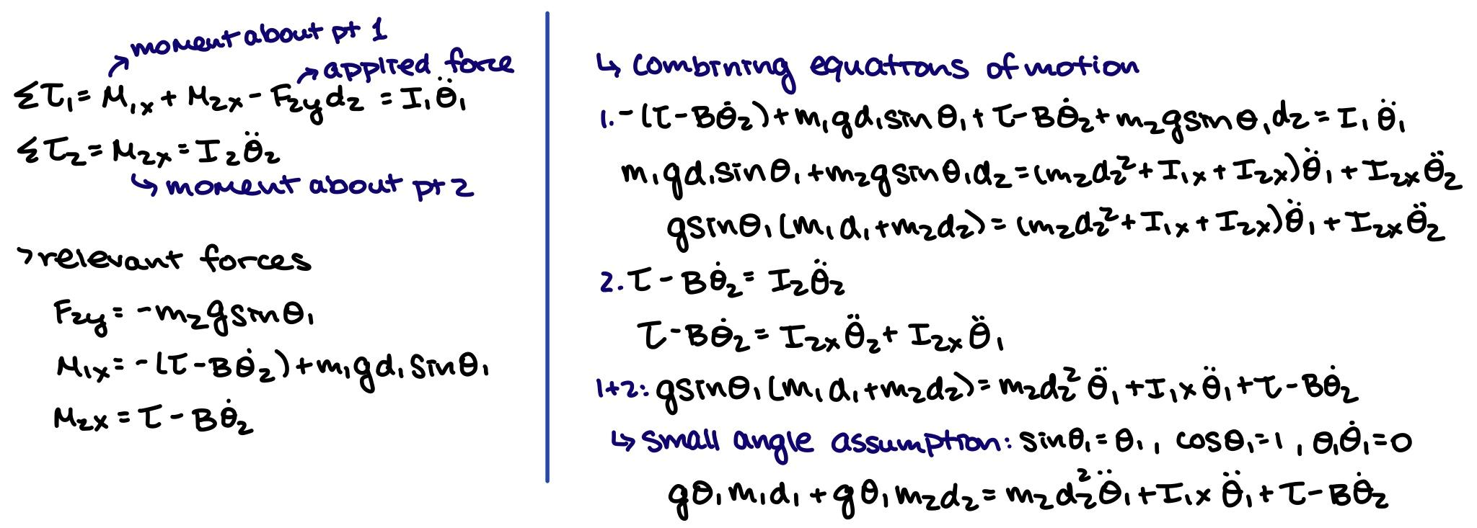
Recap: Free Body Diagram + EOM
Equation of motion describing motor torque in relation with the pitch angle. *
Simplified model of system.
Free Body Diagram.
* For full calculations please view supplementary slides at the end.
Akshita

Slide 7
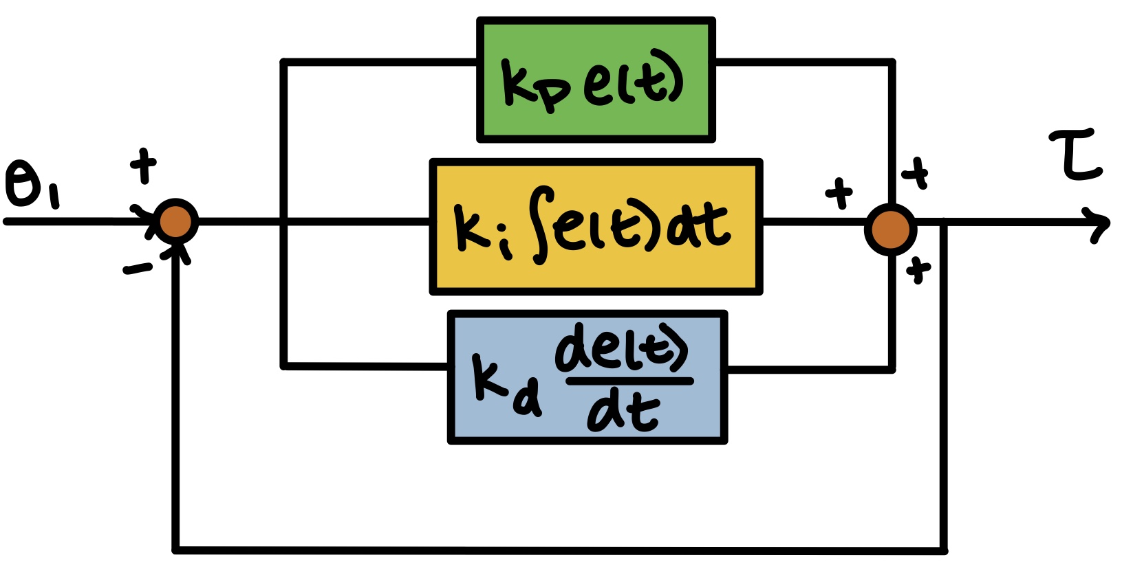
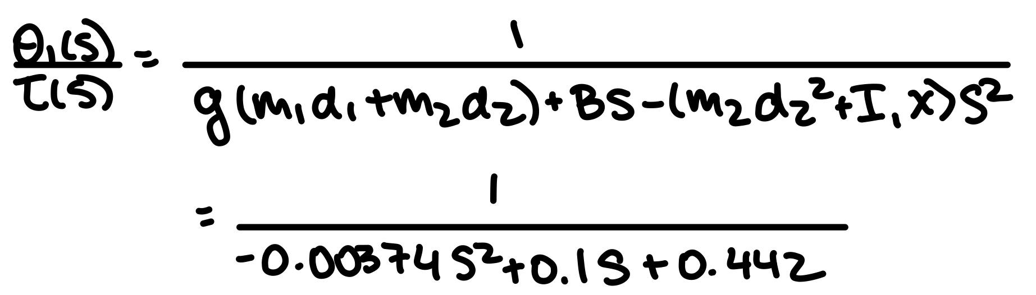
Transfer Function + PID Control
Implementing a PID feedback control for our system
Transfer function relating theta and motor torque
Akshita
Notes:
PID control uses closed-loop control feedback to keep the actual output from a process as close to the target or setpoint output as possible. The PID controller can be used to improve both the system transient response and steady state errors.

Slide 8
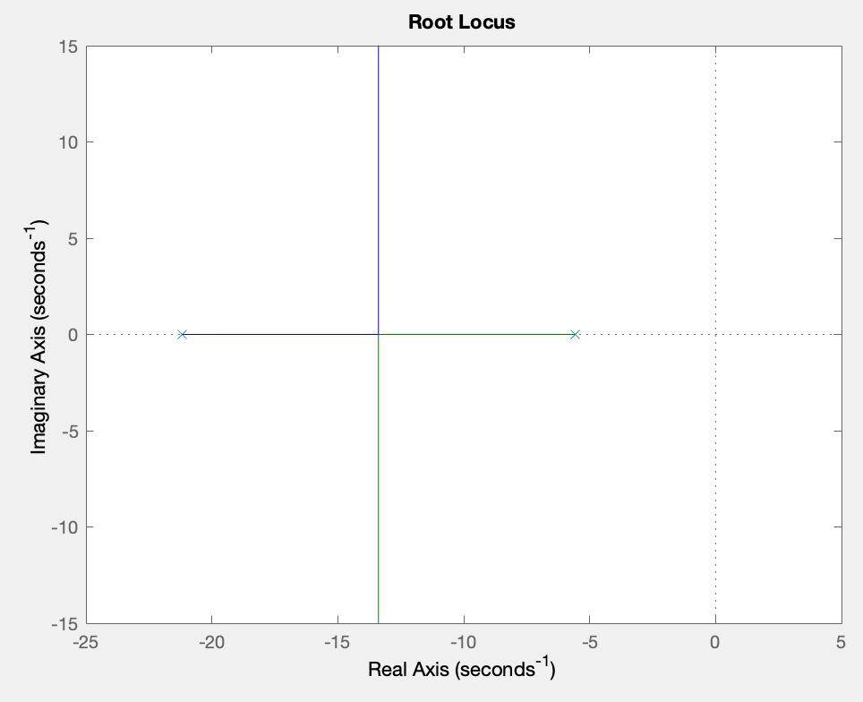
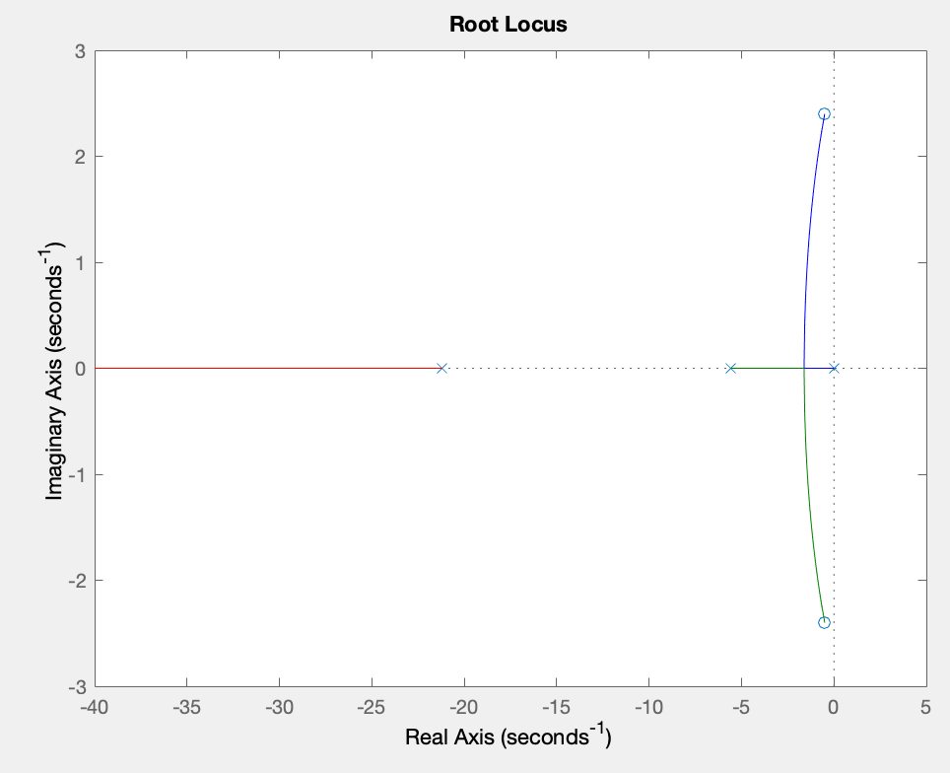
More PID Control
Addition of complex roots to change damping ratio
Stable second order system
New poles and zeros (changes system order)
Root locus before control
Root locus after adding Kp, Ki, Kd values
Akshita
Notes:
Root locus allows us to visualize the poles and zeros and see how they affect the system’s response. Changing the gain values allows us to have complex roots, allowing us to change the system’s response to either an overdamped or underdamped response and see whether the new poles and zeros make the system more stable.

Slide 9
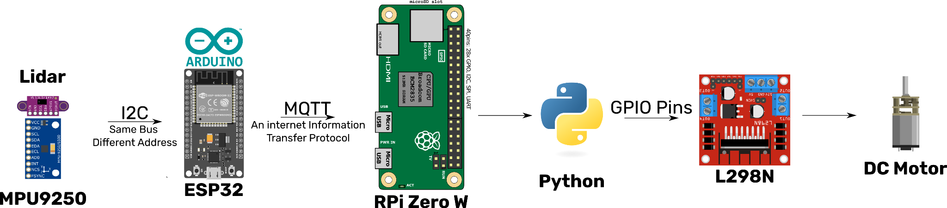
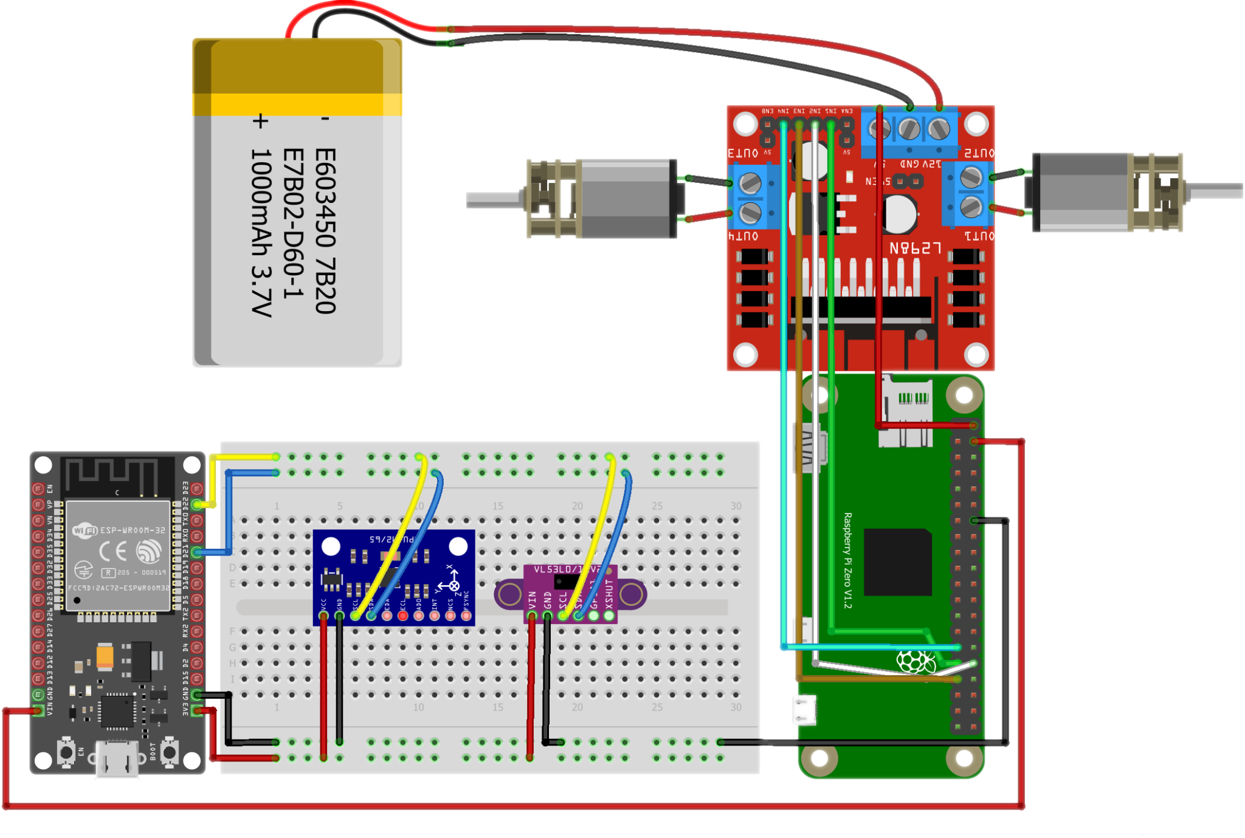
Communications Outline
Sawyer

Slide 10


Code Outline
Constantly Read Data from Sensors
Send Raw Data to RPi
Parse data from ESP32
Convert Raw Accelerometer Data to Angles
Measure Error from our Ideal Angles
Feed Error to a Proportional Controller
Sawyer

Slide 11
Thank you!

Slide 12
Supplementary Slides
Detailed diagrams and calculations for THANOS

Slide 14
Equations of Motion Calculations

Slide 15
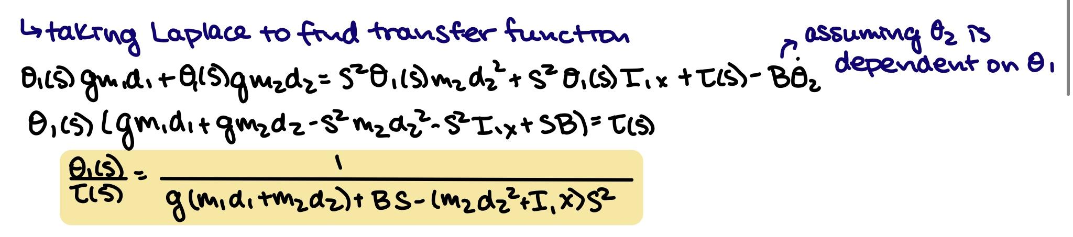
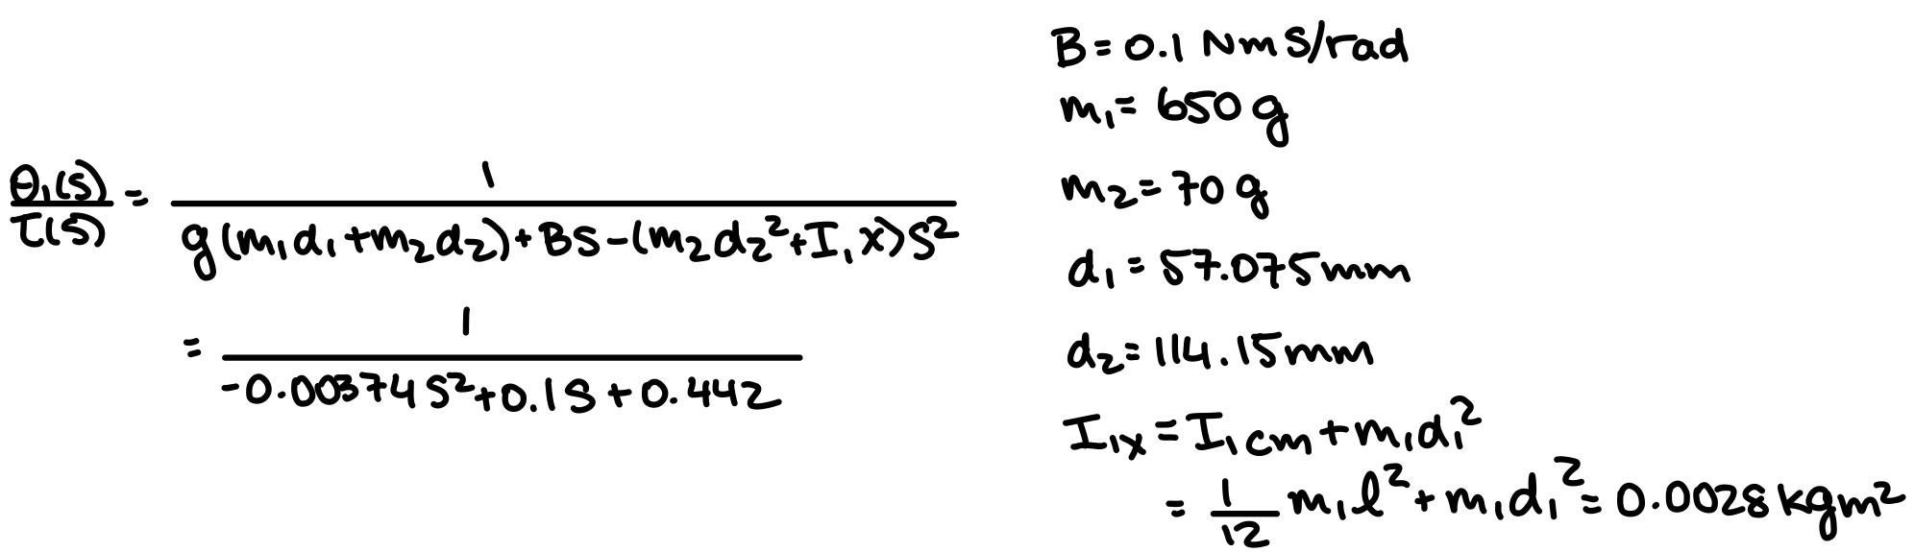
Transfer Function Derivation

